Slide 1
Credit Risk - Loan Eligibility Prediction
Classification using Model Comparison
Aditya Senthil Kumar

Slide 2
Data Background
Easy House, a finance company specializing in diverse home loans, operates in urban, semi-urban, and rural regions. Traditionally, customers apply for a home loan, and the company then assesses their eligibility.
Easy House aims to automate this process by leveraging historical customer data to create a predictive model for determining loan approval. This initiative is designed to enhance efficiency, reduce potential losses, and enable a more targeted focus on eligible customers.
Dataset contains demographic information, details of loan if they currently possess and if they have any credit history. Based on this information we are using three classification models to predict loan eligibility.

Slide 3


Model Objectives
To identify the factors to be considered to predict loan eligibility.
Perform classification analysis to determine the best model to be used in predicting loan approvals and denials.

Slide 4
Classification Models
Classification models are well-suited to problems involving the prediction of two or more categorical outcomes.
1. KNN - Classify new data by voting among its closest neighbors in the feature space.
2. Random Forest - Ensemble learning method for classification that operates by constructing a multitude of decision trees at training time. The output of the random forest is the class selected by most trees.
3. Naive Bayesian - Presumes independence between features provided in the class label.

Slide 5

Model Evaluation
Understanding the inaccurate predictions -
Falsely identifying loan eligibility for an ineligible person.
Incorrectly deeming an eligible person as ineligible.
Emphasizing on the significance of the latter misprediction, as it can adversely impact the company's business by potentially losing customers and disrupting sales and revenue projections.

Slide 6
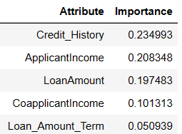
Exploratory Data Analysis
Overall Loan Approval Rate – 69%
Gender → (male→69% / female→62%)
Married →65% / Unmarried →60%
Graduates →63% / Non-Graduates →58%
Self employed→69%/ Not Self Employed →65%
Bad credit history →<10% / Good credit history→>80%
Highly Correlated → Loan Amount and Applicant Income
Important Features to build the final model →

Slide 7
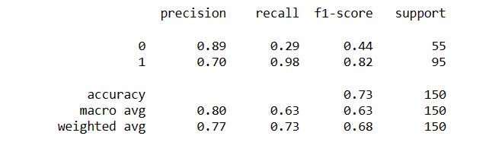
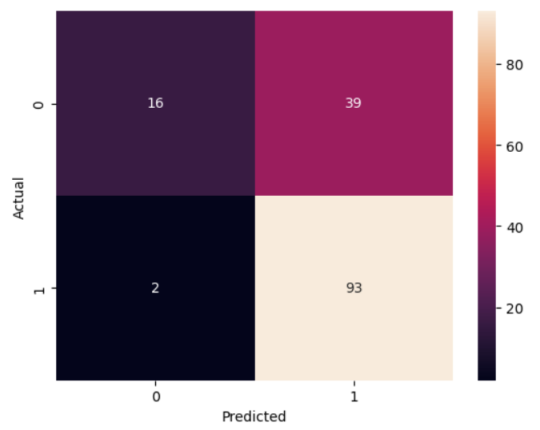
Results - KNN Model
This is the result of test set. We can see that
the overall accuracy of the model is around
73% compared to that of train set, that is
81%.
The number of false positives are 39 and
False negatives are 2.
The recall for this model is 0.98 for class 1
and 0.29 for class 0.
The precision for this model is 0.70 for class 1
and 0.89 for class 0.

Slide 8
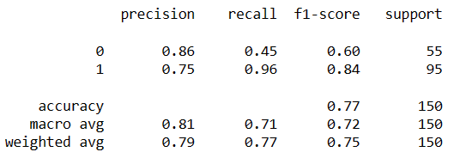
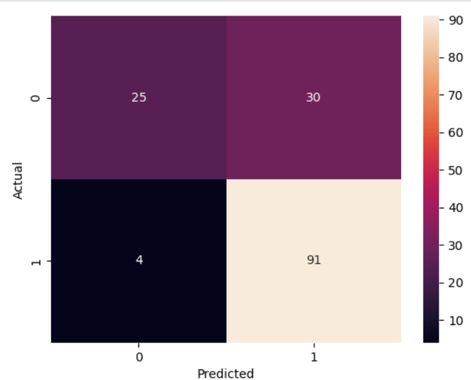
Results - Naive Bayesian Model
The overall accuracy of the model is around
77% compared to that of train set, that is
81%.
The number of false positives are 30 and
False negatives are 4.
The recall for this model is 0.96 for class 1
and 0.45 for class 0.
The precision for this model is 0.75 for class 1
and 0.86 for class 0.

Slide 9
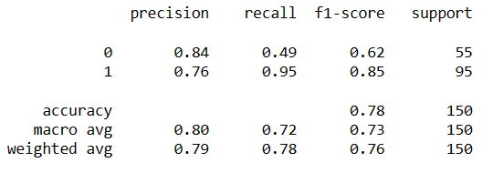
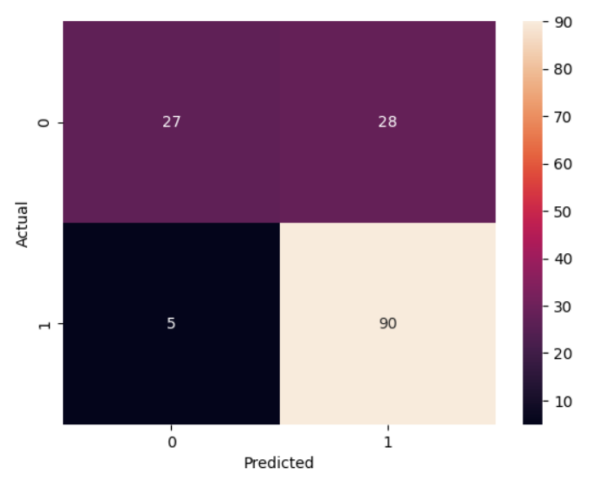
Results - Random Forest Model
This model has a slightly higher accuracy (78%)
compared to the other two models and the
Company can possibly use this model to predict
Whether a person is eligible to avail a loan or
not.
This model can be tuned further to get a better
accuracy.
The recall for this model is 0.95 for class 1
and 0.49 for class 0.
The precision for this model is 0.76 for class 1
and 0.84 for class 0.

Slide 10
Conclusions
From the analysis, it is evident that KNN yields a 73% accuracy, Naive Bayesian offers 77%, and Random Forest provides a 78% accuracy in predicting loan eligibility. Given these results, Easy House can place confidence in the Random Forest classifier.

Slide 11
Recommendations
Develop an early warning system for employee turnover.
Customize predictive models for sales and marketing roles.
Integrate performance metrics for personalized incentives.
Ensure compensation aligns with industry standards.
Consider cultural and environmental factors in the model.
Provide support or incentives for employees with longer commutes.
Enhance managerial involvement for improved job satisfaction.
Establish a feedback loop for continuous model improvement.
Integrate employee survey data for a holistic understanding

